Slide 1
Robots in Health and Social Care Environment
Jordan Hamilton
Research Associate at the University of York

Slide 2
Background
Joined the University of York in June 2021 as a Research Associate in Assistive Care Robotics working on the ALMI Project
Collaborate on other projects, such as the CSI:Cobot and DAISY Project
Undergraduate degree in Aerospace Engineering
PhD in Flight Dynamics and Control

Slide 3
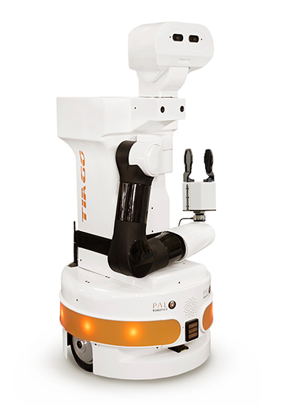
ALMI Project
Introduction
Ambient Assisted Living for Long-Term Monitoring and Interaction
Use of service robots to support patients who might be suffering from mild cognitive or motor impairment
Allow patients to continue an independent lifestyle in their own homes
Joint venture between the University of York and PAL Robotics – utilising the TIAGO robot

Slide 4
ALMI Project
Overview and Aims of the Project
TIAGo aims to interact with the user through speech and provide assistance through reminders during tasks
Help the user perform physical tasks in their own home with safe manipulation of household objects
Perform cooperative meal preparation between TIAGo and the patient
TIAGo retrieves objects and provides step-by-step guidance on the meal preparation process
Environmental and emergency monitoring of the patient

Slide 5
ALMI Project
Concerns and Barriers of Autonomous Systems in Social Care
Safety concerns since the robot is operating in uncertain and changing environments and operating in close proximity with an untrained and frail user.
During cooperative tasks, navigation and manipulation of household objects → Safety of the human MUST be guaranteed
Privacy concerns surrounding how image processing and speech recognition is used in a home environment
Adaptability of the system and changes to the ambient conditions

Slide 6
ALMI Project
Expected Outcomes
Ensure that TIAGo can interact with a human to accomplish a common goal
TIAGo will provide advice and recommendations to the patient on the order of operation for a specific task
TIAGo manipulates household-items efficiently and safely
TIAGo performs environmental monitoring and triggers emergency procedures in the event the patient has fallen or is unresponsive
Navigation of the environment maximises safety whilst also ensuring a task can be completed in good time

Slide 7
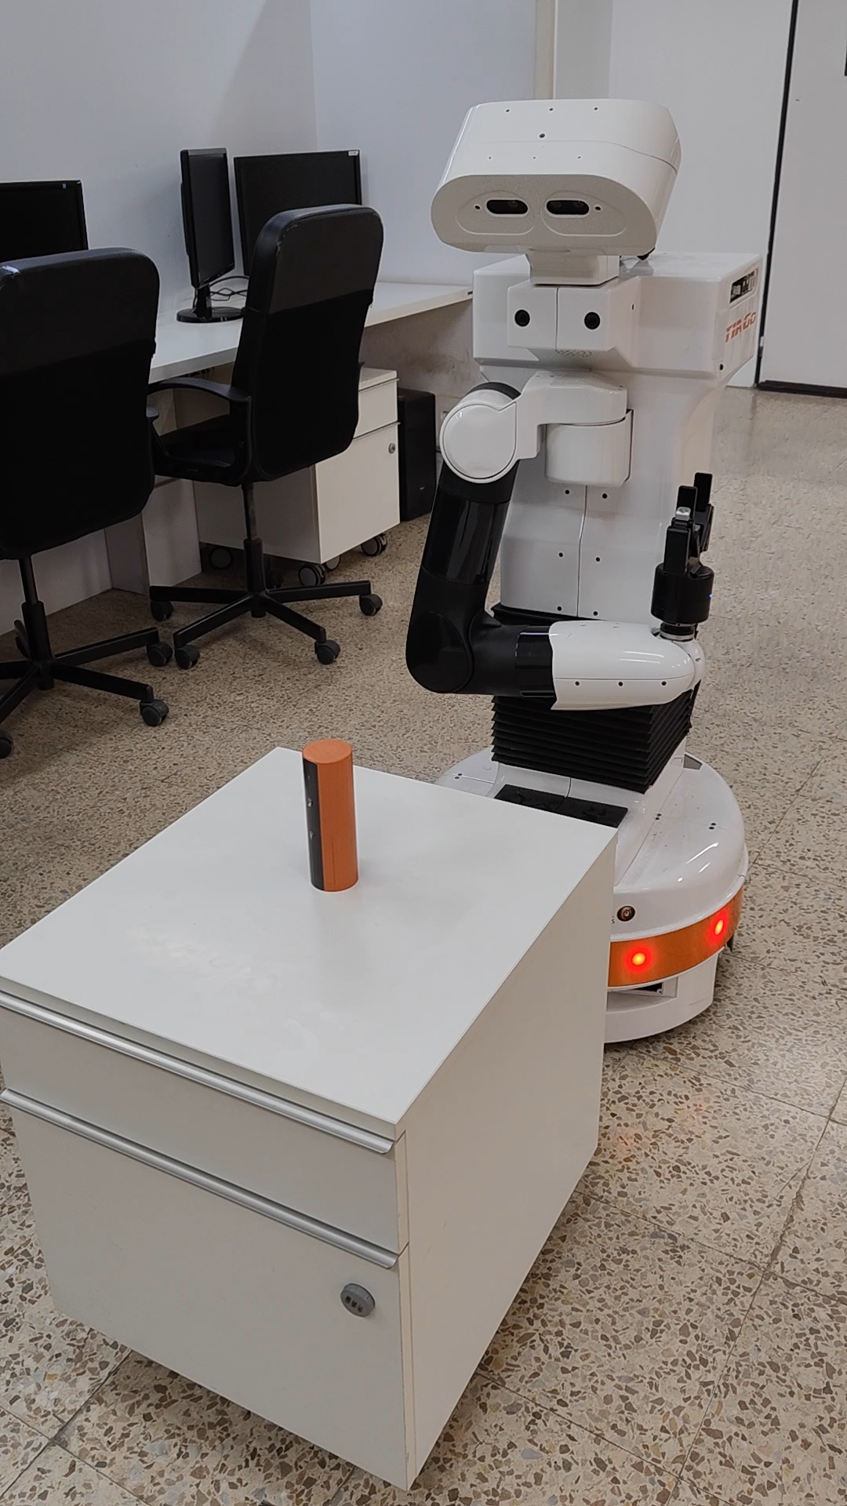
ALMI Project
Work Packages
Extend TIAGO’s Safe Assisted-Living Support (PAL)
Ensure TIAGo complies with safety standards
Perform environmental monitoring and identification of hazards
Create a repertoire of object locations
Safely manipulate household-items

Slide 8
ALMI Project
Work Packages
Modelling, Verification and Adaptation (UoY)
Environment, user and system modelling
Predictive modelling of human behaviour
Navigational modelling for path finding
Mission modelling and task deliverance
Robot configuration and adaptation
Quantitative verification of the system

Slide 9
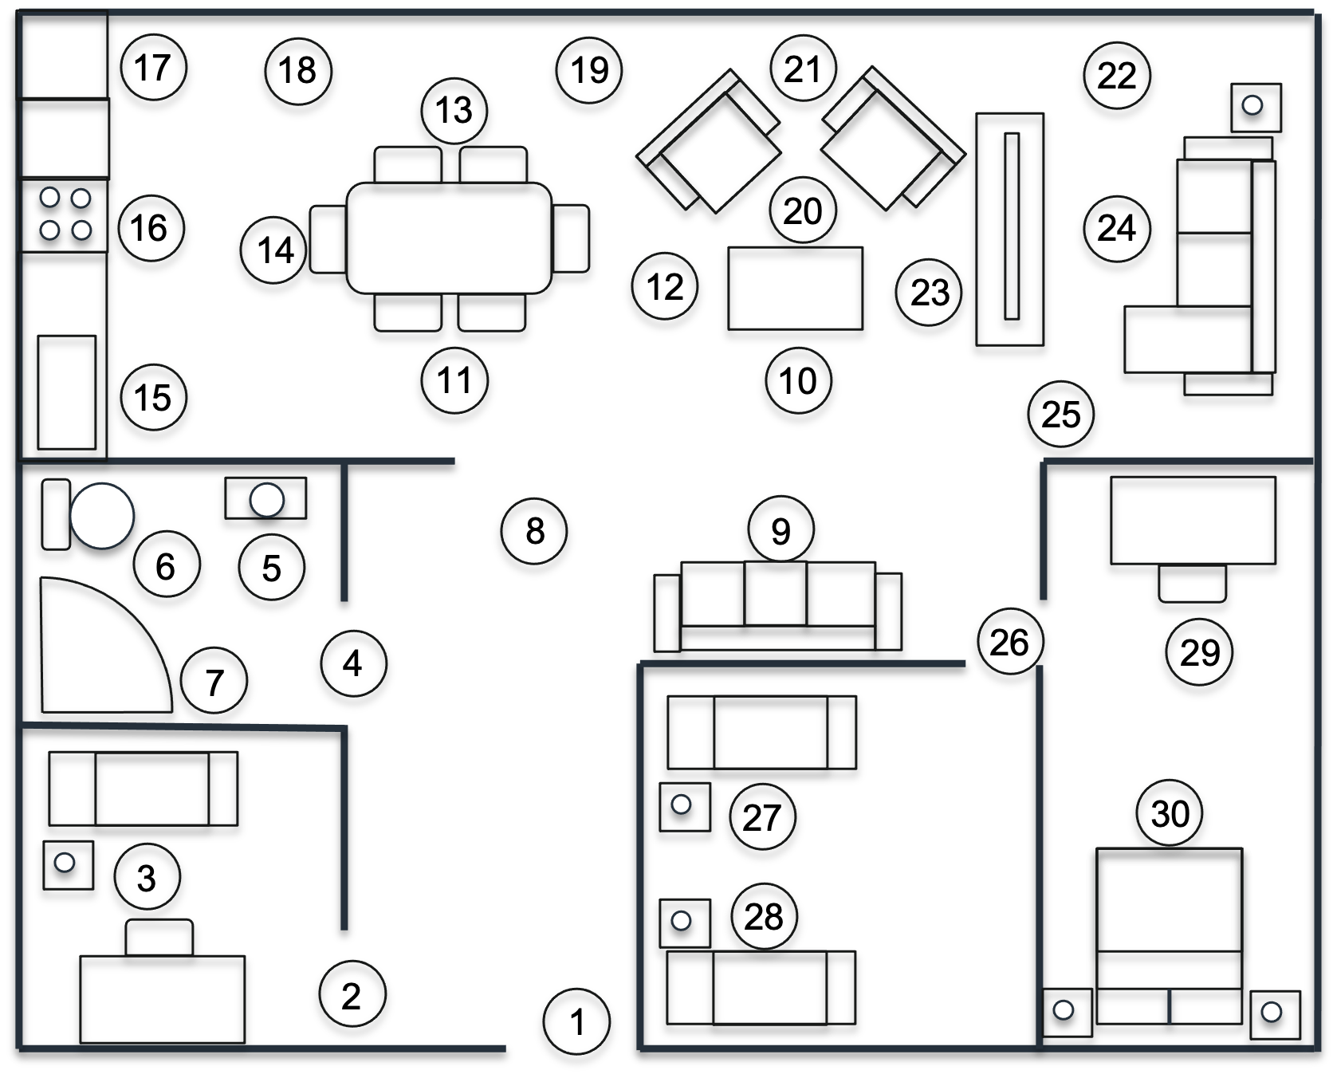
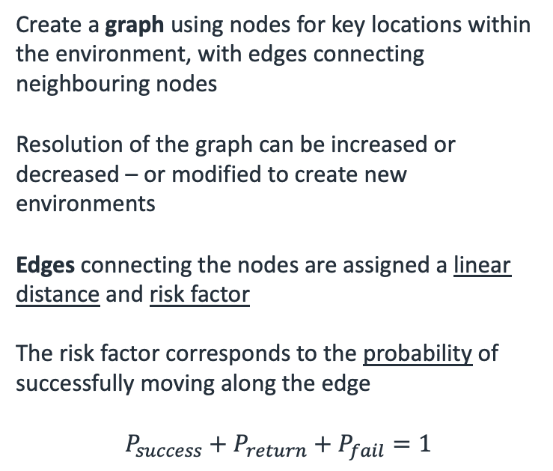
ALMI Project
Create a graph using nodes for key locations within the environment, with edges connecting neighbouring nodes
Resolution of the graph can be increased or decreased – or modified to create new environments
Edges connecting the nodes are assigned a linear distance and risk factor
The risk factor corresponds to the probability of successfully moving along the edge
$$P_{success}+P_{return}+P_{fail}=1$$
Environment Modelling

Slide 10
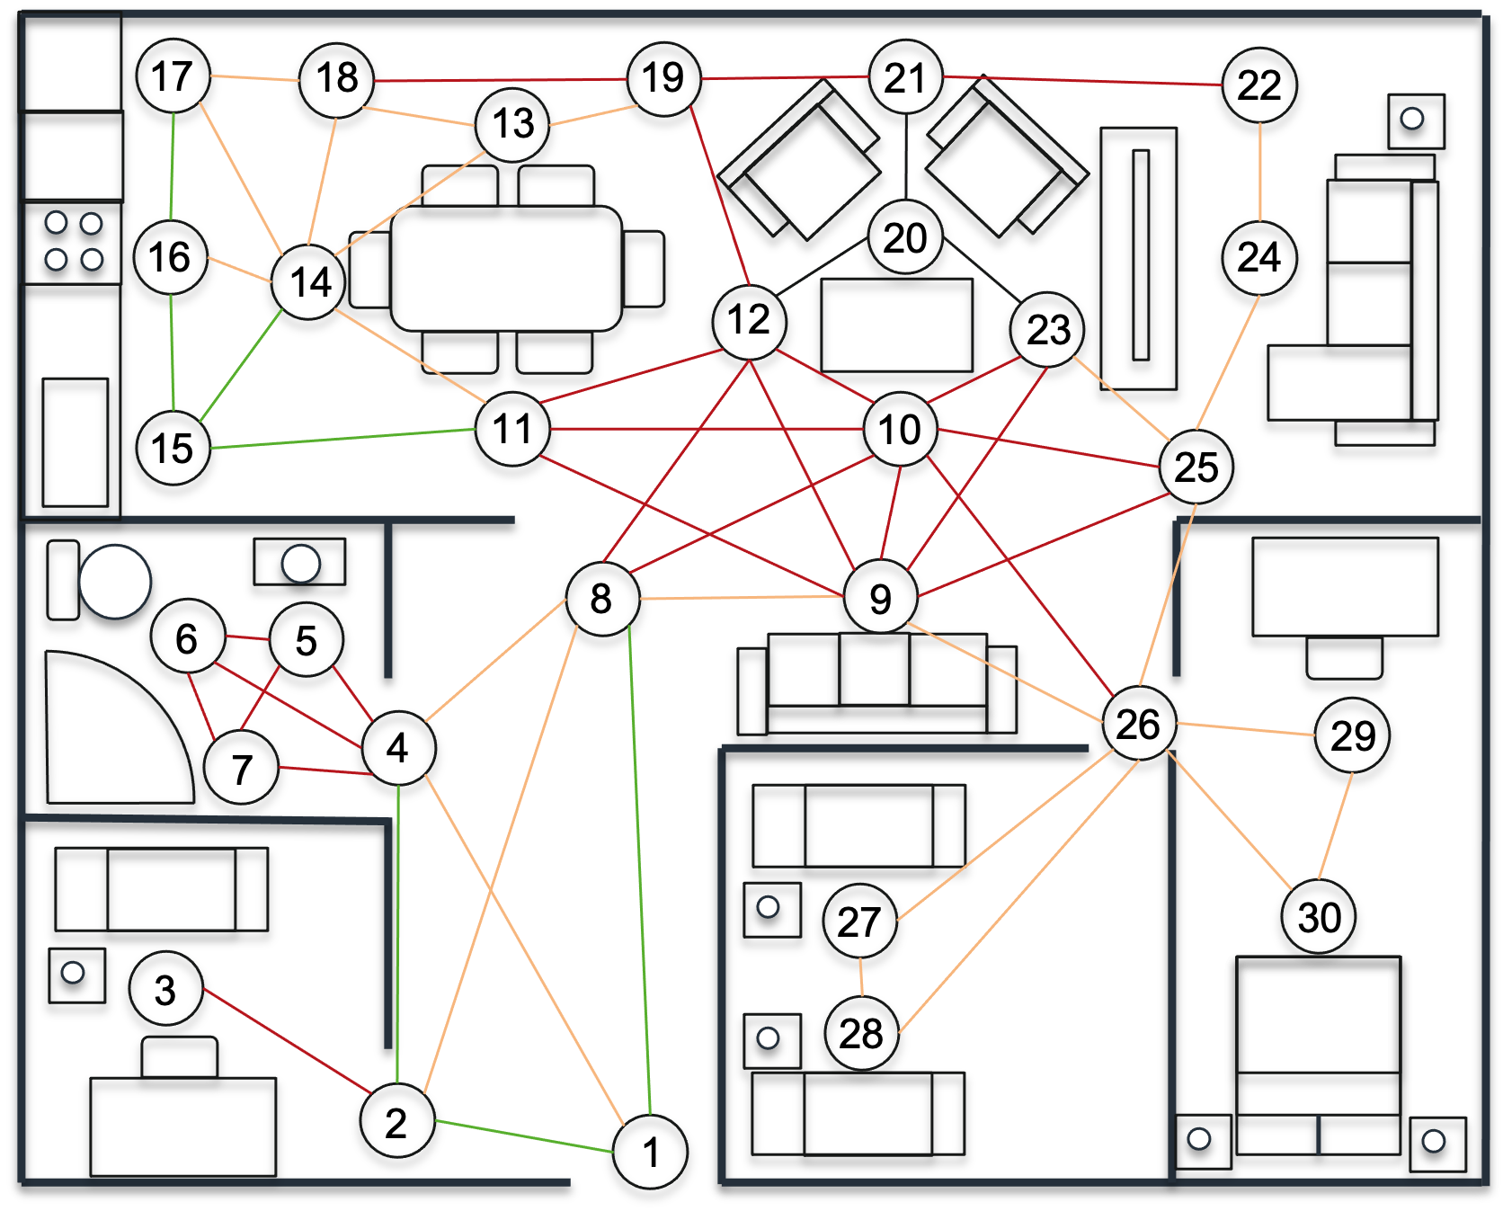
ALMI Project
Environment Modelling
Each edge is weighted:
Green low risk
Orange medium risk
Red high risk
Back very high risk
Risk categories are assigned based on clutter and also whether they intersect one or more edge

Slide 11
ALMI Project
Path Finding – Dijkstra’s Algorithm
Shortest distance path between nodes in a graph
3
1
1.8
1
5
Shortest Distance Path:
1.2
1
3
5
2
0.8
0.6
4
2
1.5

Slide 12


ALMI Project
Path Finding – Modified Dijkstra’s Algorithm
Adjust the parameters of the algorithm to maximise a parameter, such as probability
Rather than a distance value, each edge has a probability of success ${(P}_{s})$ and failure $(1−P_{s})$
3
0.4
0.7
0.5
0.2
Highest Probability Path:
1
2
4
5
1
0.2
5
0.4
0.5
$0.7 × 0.7 × 0.9≈$ 44%
0.7
0.6
0.3
0.8
0.9
Shortest Distance Path:
1
3
5
0.7
4
$$0.5 × 0.2=10\%$$
2
0.3

Slide 13
ALMI Project
Path Selection
Which path do we chose?
3
0.4
3
0.7
1
1.8
0.5
0.2
1
5
1
5
1.2
0.4
0.5
0.2
2
0.6
0.3
0.8
0.7
0.9
0.6
0.8
4
0.7
4
2
1.5
2
0.3
Least distance?
Highest probability of success?

Slide 14
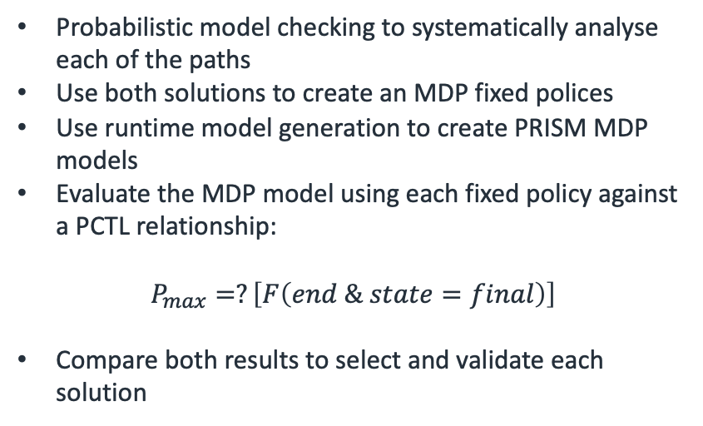
ALMI Project
Path Finding – Quantitative Verification
3
1
1.8
Probabilistic model checking to systematically analyse each of the paths
Use both solutions to create an MDP fixed polices
Use runtime model generation to create PRISM MDP models
Evaluate the MDP model using each fixed policy against a PCTL relationship:
$$P_{max}=?\left[F\left(end \& state=final\right)\right]$$
Compare both results to select and validate each solution
1
5
2
1.2
0.8
0.6
4
2
1.5
0.4
3
0.7
0.5
0.2
1
0.2
0.4
0.5
0.7
0.6
0.3
0.8
0.9
0.7
4
2
0.3

Slide 15
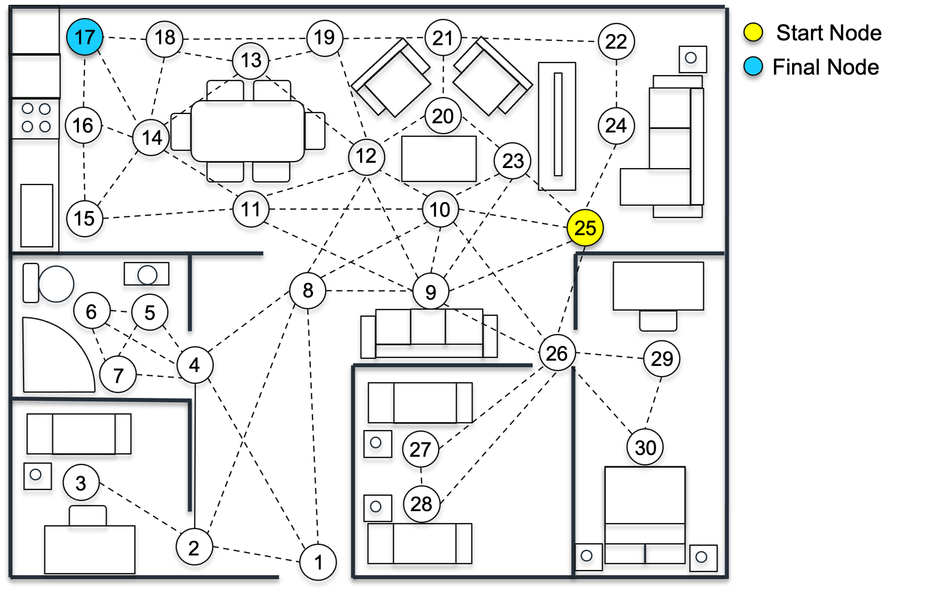
ALMI Project
Path Finding – Example

Slide 16
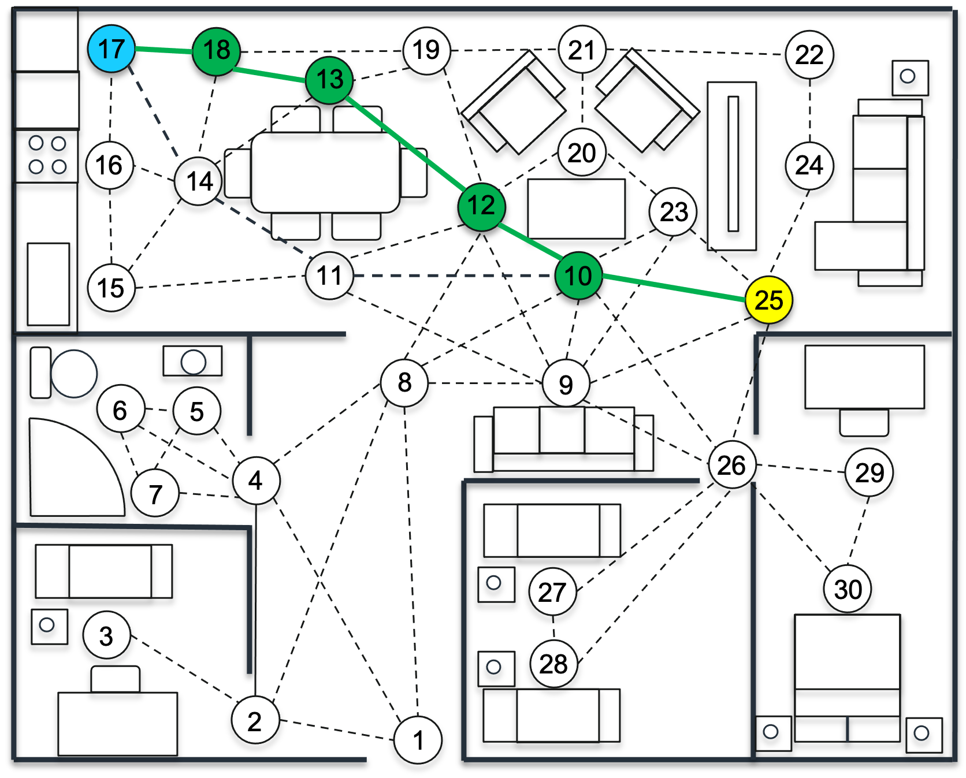
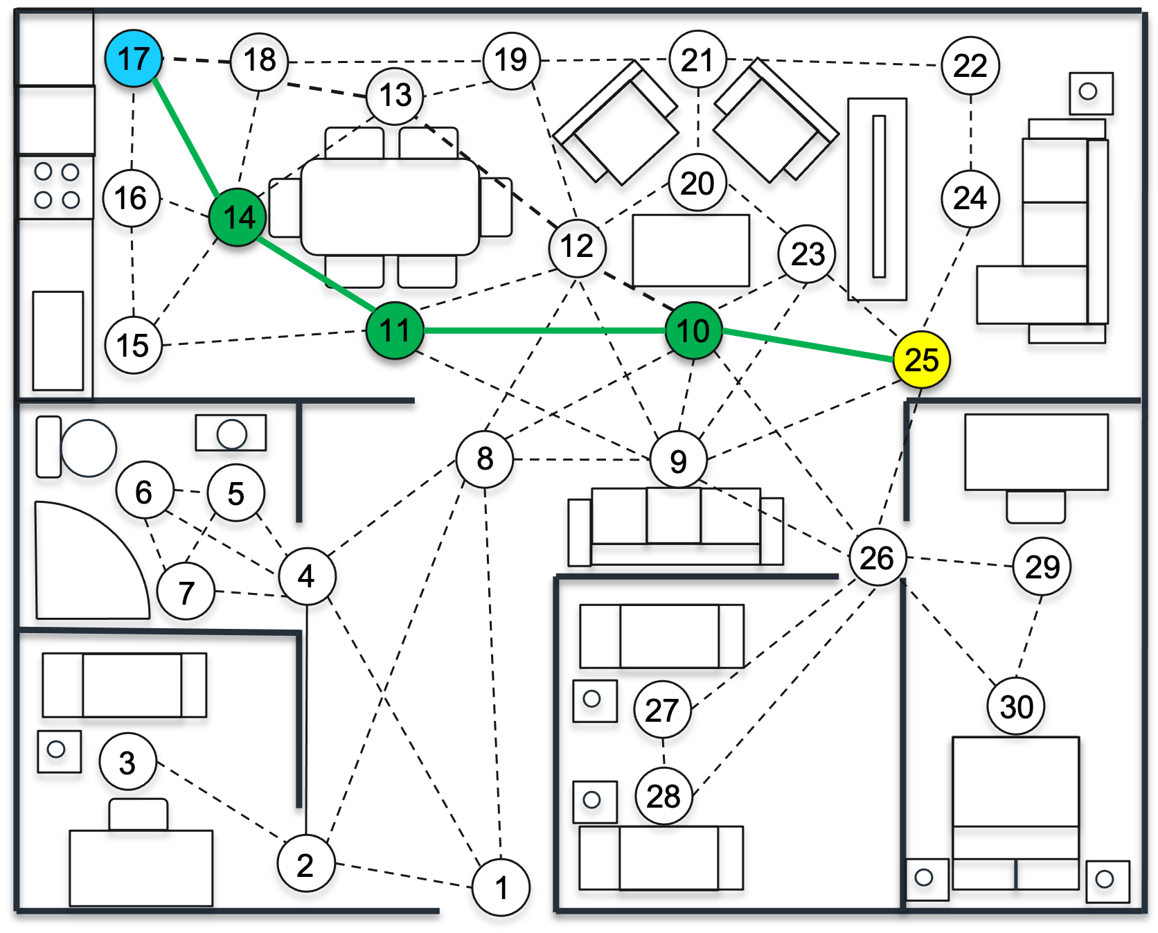
ALMI Project
Path Finding – Example
Least Distance
Highest Probability of Success

Slide 17
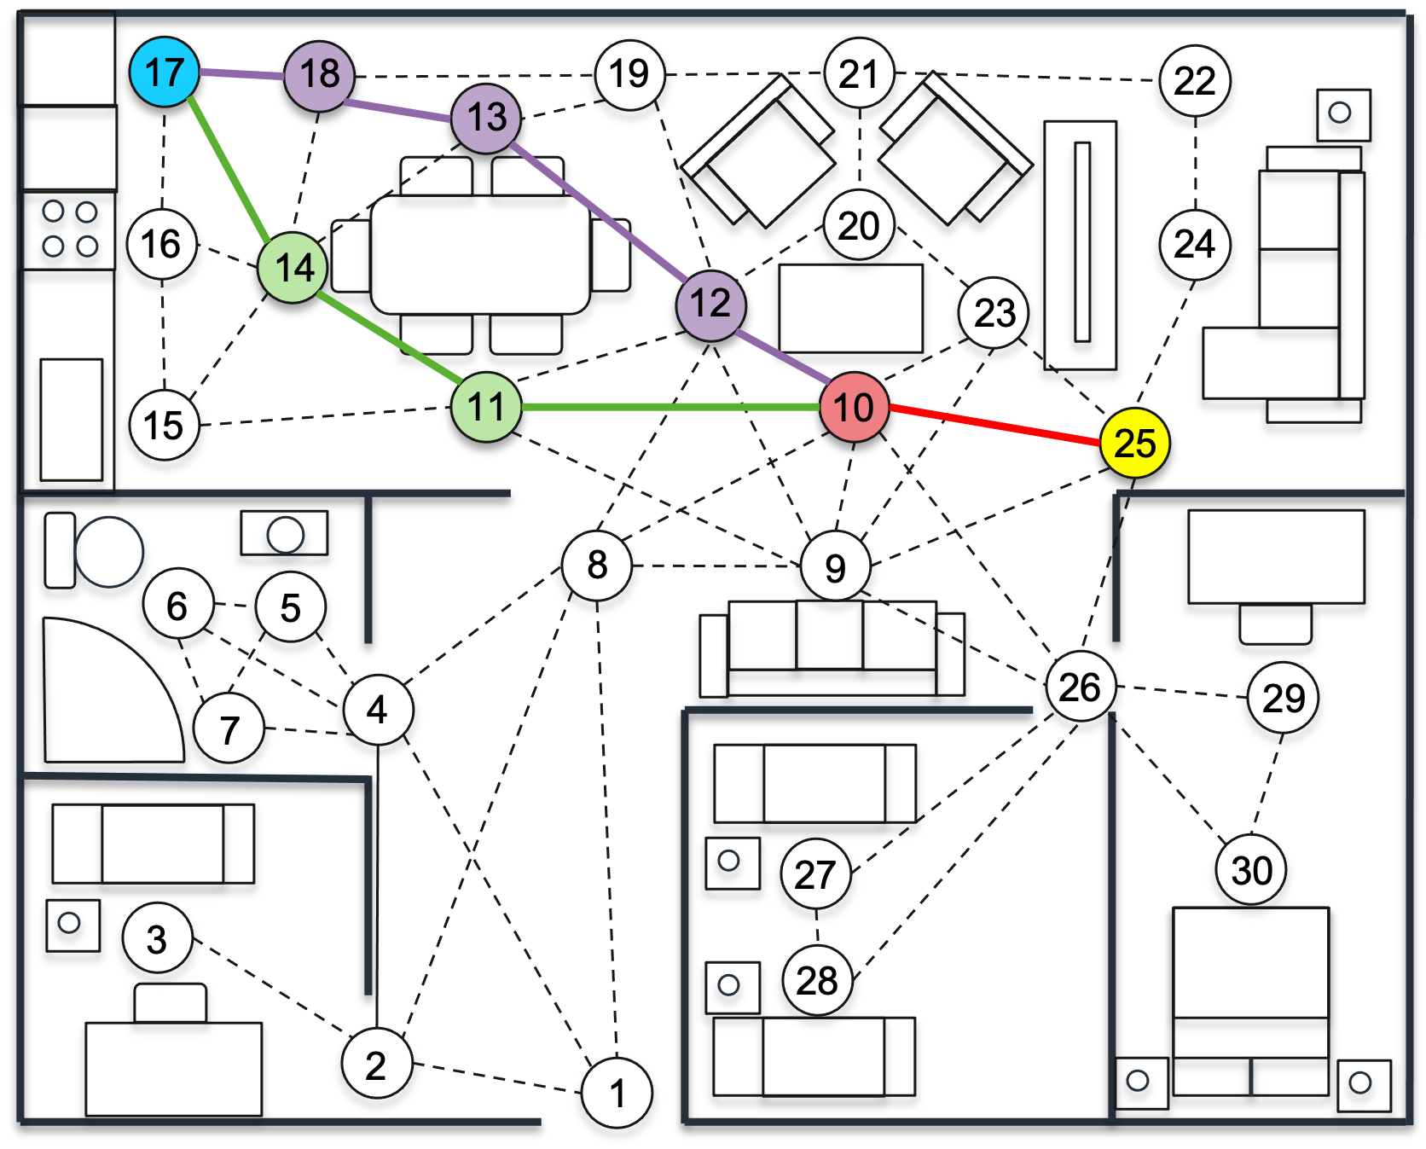
ALMI Project
Path Finding – Example
Start Node
Final Node
Highest Probability Path (Robot)
Minimum Distance Path (Robot)
Mutual Path (Robot)
Minimum distance path is 2.9 m with 58% chance of success
Maximum probability path is 4.0 m with 92% chance of success

Slide 18
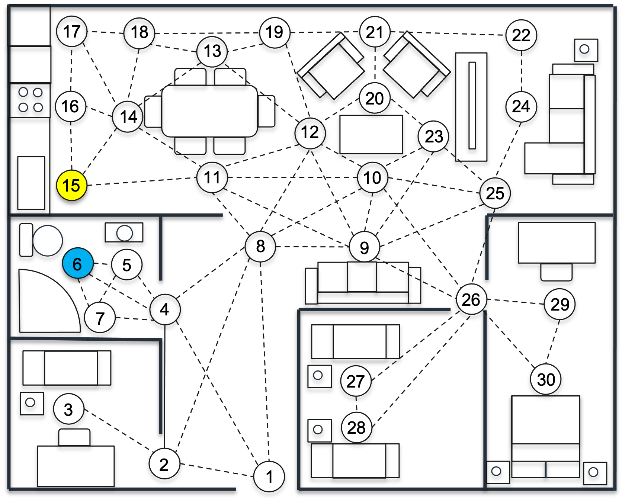
ALMI Project
Path Finding – Example with Human
Assumed the human will travel along the path of the least distance

Slide 19
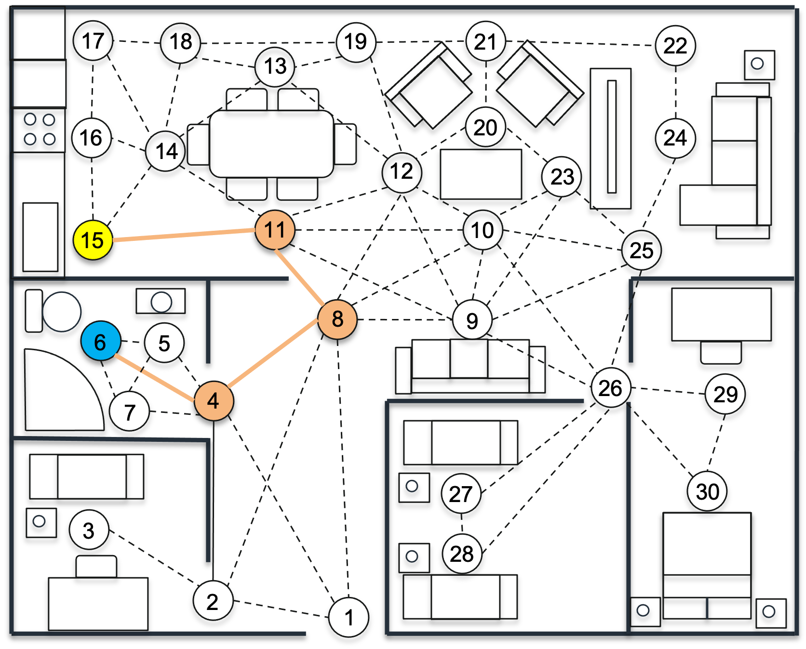
ALMI Project
Path Finding – Example with Human
This path causes a spatial conflict with the path of the robot’s path

Slide 20
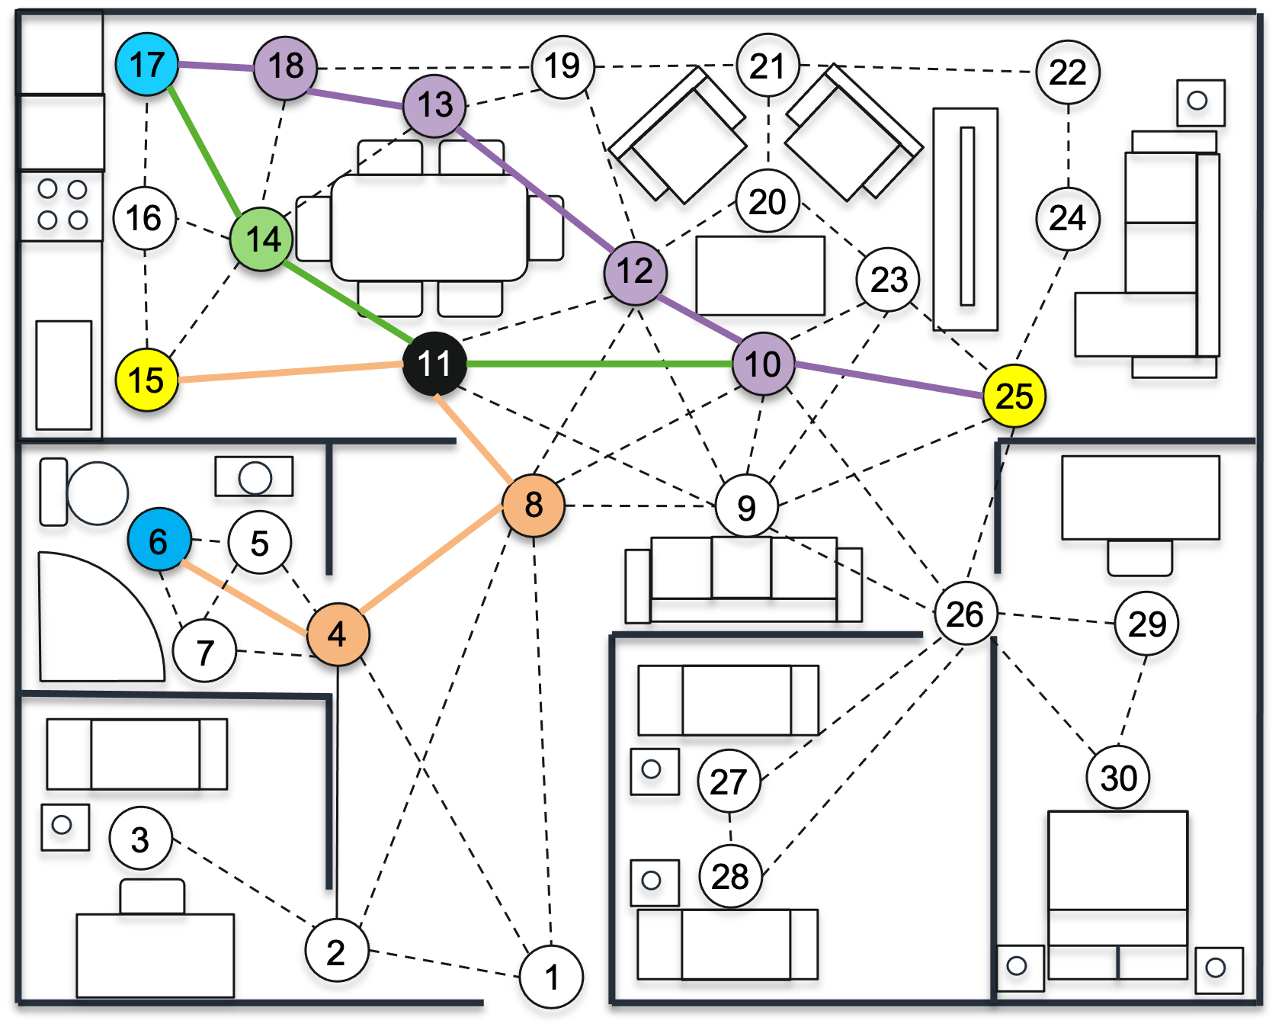
ALMI Project
Path Finding – Example with Human
Highest probability of success path no longer holds true…
Introduce a heat map for the robot which artificially the risk associated with edges and nodes predicted to be on the humans path
Use the heat map to perform path finding for the robot
Chance of success decreased from 92% → 23%

Slide 21
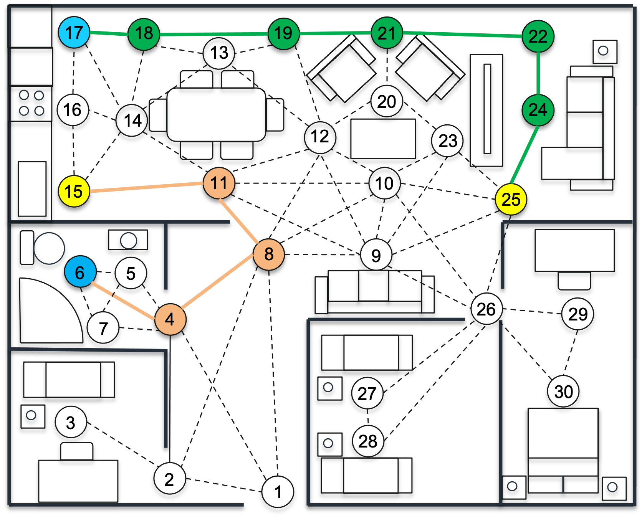
ALMI Project
Path Finding – Example with Human
The agent now re-plans it’s path around the environment, increasing the probability of reaching the final node
Maximum probability path is 4.8 m with 81% chance of success

Slide 22
What does this mean?
Require knowledge of the human’s position and intentions
This could be a fair assumption if we were guiding the human to locations during a cooperative task…
Requires accurate predictions of the human’s behaviour
How they will navigate through the environment?
Assume the human takes the least distance path (Factor some creativity?)
Working on spatial deconfliction (not temporal & spatial deconfliction)
Future work for time-based simulations with kinematic movement analysis?
Purely predictive behaviour?
Adaptation at runtime?
These are all thing we need to consider in the final solution

Slide 23
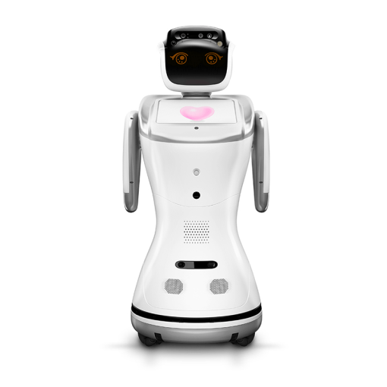
DAISY Project
Introduction
Multidisciplinary collaboration between University of York, University of Southampton and York and Scarborough Teaching Hospitals
Early stages of research
Develop a robot-assisted A&E triage system
Davinci Algorithm developed by clinician
Sanbot Elf robot running

Slide 24
DAISY Project
Overview
Patient Intake
Initial Triage
Secondary Triage
Consultation
DAISY Triage
Consultation

Slide 25
DAISY Project
Requirements
Autonomous system which guides a patient through the triage process
Patient provides demographic information and subjective information relating to their symptoms
Patient provides vital sign objective information, such as blood pressure, blood oxygen level, temperature and respiratory rate
Information is collated and passed through the Davincin algorithm
The assessment provides a clinician with an advisory course of treatment and additional tests to be conducted.

Slide 26
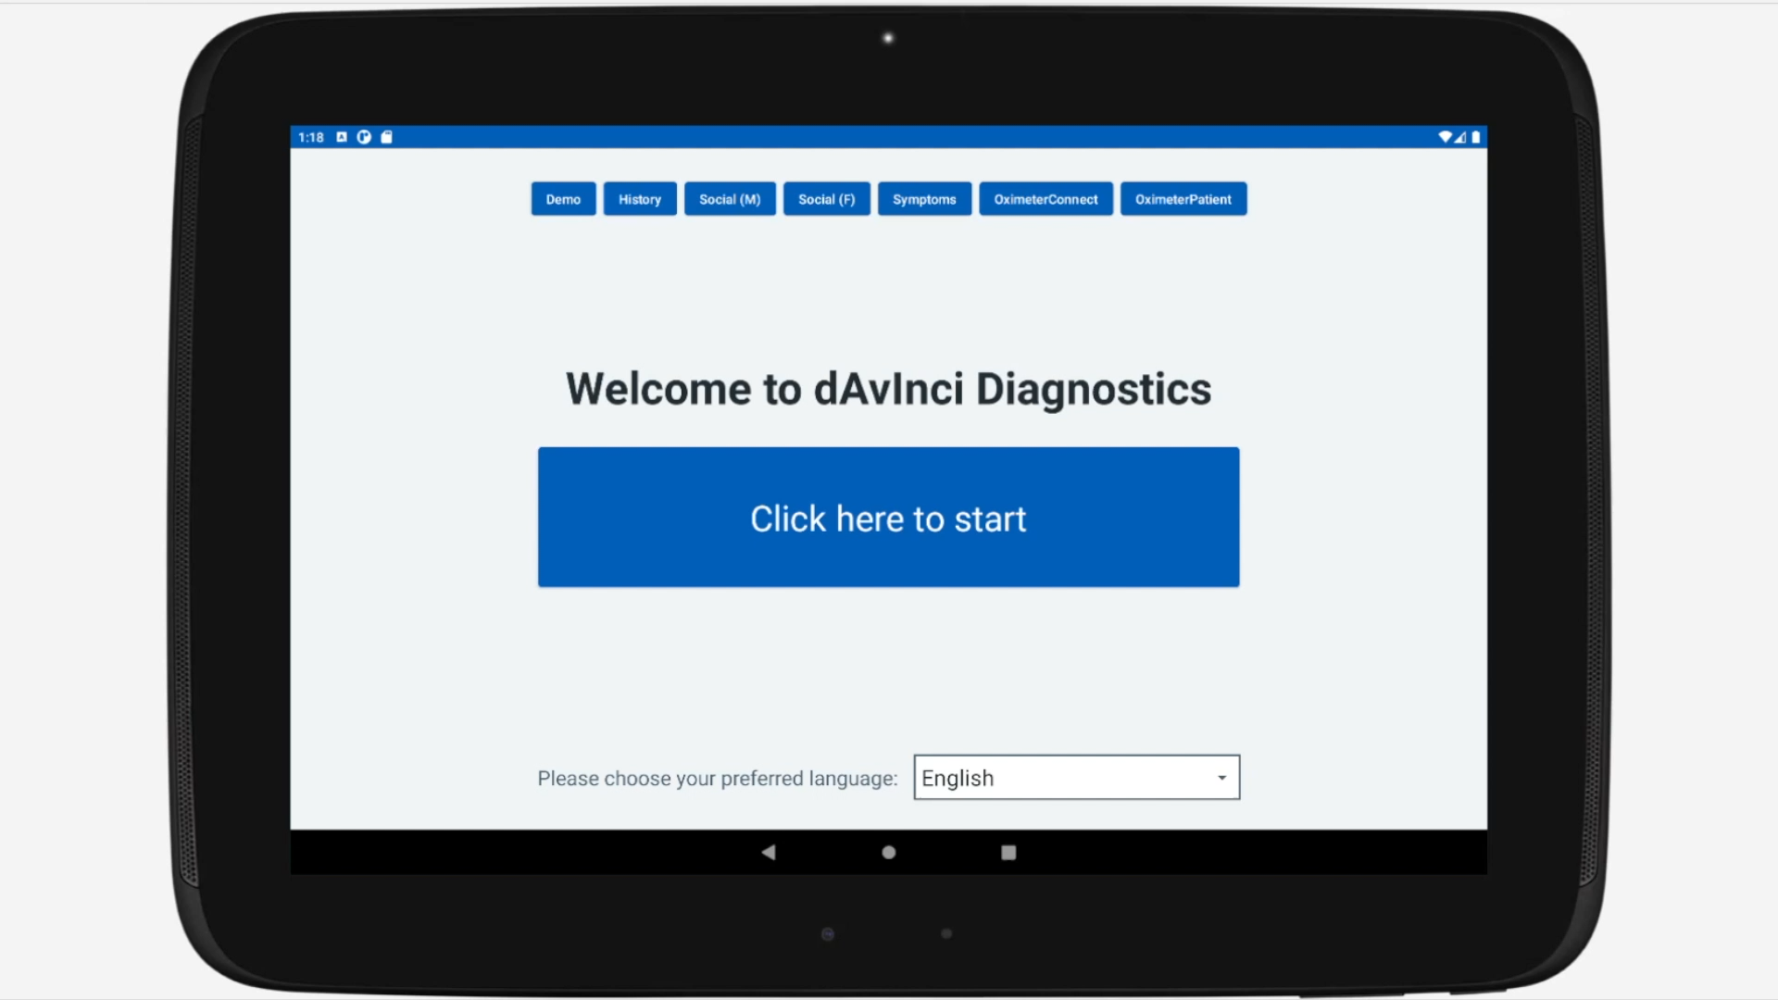
DAISY Project
Application Demonstration
Developed in Kotlin
Represents the Davinci triage process with subjective information questioning
Connects to external medical devices for vital sign objective analysis
Provides predictive diagnosis and advice for treatment

Slide 27
Questions?

